Slide 1
Agenda
User Interface [Kevin]
Information Retrieval Process [Pritom]
Indexing & Searching [Petros]
Ranking Methods [Kevin]
Performance & Example Queries [Oliver]
Challenges [all]
Future Improvements [Oliver]

Slide 2
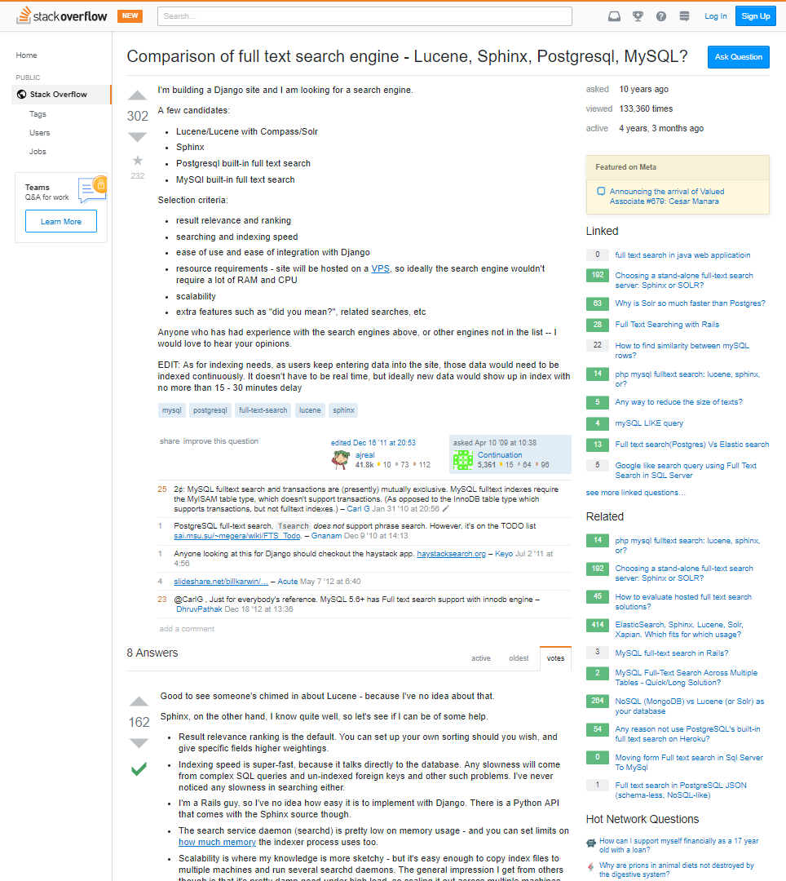
Information Retrieval Process
Title [ String ]
Date [ Date ]
Views [ Integer ]
Tags [ String[] ]
Related Question [ String[] ]
Question
Question [ String ]
Code [ String ]
Votes [ Integer]
Answer
Answer [ String ]
Accepted Answer [Boolean]

Slide 3
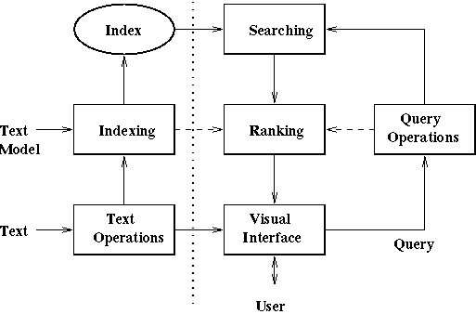
Information Retrieval Process
Index on MongoDB
Retrieve Docs with at least one term occurence
English language dictionary + authored Stack-overflow Tags
Indexing with Gap-Lists
Ranking (tf-idf + empirical scoring)
Plaintext Query, Page regions
Titles, Questions, Tags, Answers
Stopwords Removal, Extract Code
Web Interface (including Tags)
Single User
Modern Information Retrieval © Addison-Wesley-Longman Publishing co. 1999 Ricardo Baeza-Yates, Berthier Ribeiro-Neto

Slide 4
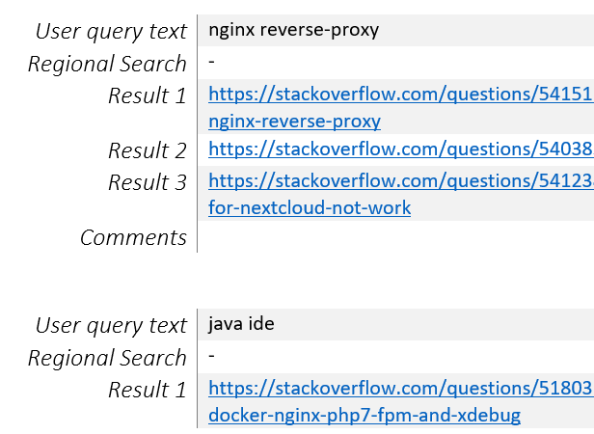
Performance & Example Queries
Think of developer’s information need and corresponding queries
Use Google Search for only Stackoverflow results (one day for calibration)
Filter for date range 06/05/2017 to 06/05/2019
Cross-validate results with Stackoverflow built-in ElasticSearch results
Return ranked top 5 questions

